Slide 1

TITLE : CUSTOMER SHOPPING BEHAVIOR ANALYSIS
Uncovering insights from 3,900 purchases to guide strategic business decisions
By: karan kumar
karankrtech@gmail.com

Slide 2
BUSINESS PROBLEM STATEMENT
Understand customer buying behavior
Identify high-value customers
Improve revenue using data insights
Optimize marketing strategy

Slide 3
DATASET OVERVIEW
Total Purchases: 3,900
Total Columns: 18
Missing Values: 37 (Review Rating)
Includes:
Customer demographics
Purchase behavior
Product details

Slide 4
DATA PREPARATION (PYTHON)
Data loaded using Pandas
Initial exploration (shape, info, stats)
Missing values handled (median)
Feature Engineering:
Age groups
Purchase frequency

Slide 5
DATA STORAGE & SQL ANALYSIS
Data stored in PostgreSQL / SQL
Queries used for:
Revenue analysis
Customer segmentation
Product performance

Slide 6
REVENUE BY GENDER
Female customers spend slightly more
Male customers slightly lower revenue
Insight: Gender-based marketing can increase profit

Slide 7
HIGH-VALUE DISCOUNT USERS
Customers who spend more + use discounts
Insight:
Smart shoppers = high opportunity segment

Slide 8

TOP RATED PRODUCTS
Blouse ⭐⭐⭐⭐⭐
Dress ⭐⭐⭐⭐⭐
Shirt ⭐⭐⭐⭐

Slide 9
SHIPPING IMPACT
Express: $65 avg purchase
Standard: $58 avg purchase
Insight:
Express users spend more (12% higher)

Slide 10
SUBSCRIPTION IMPACT
68% higher spending
45% revenue from subscribers
78% repeat purchases
Insight:
Subscription = high loyalty

Slide 11
CUSTOMER SEGMENTATION
Loyal: 15%
Returning: 35%
New: 50%
Goal:
Convert New → Returning → Loyal

Slide 12
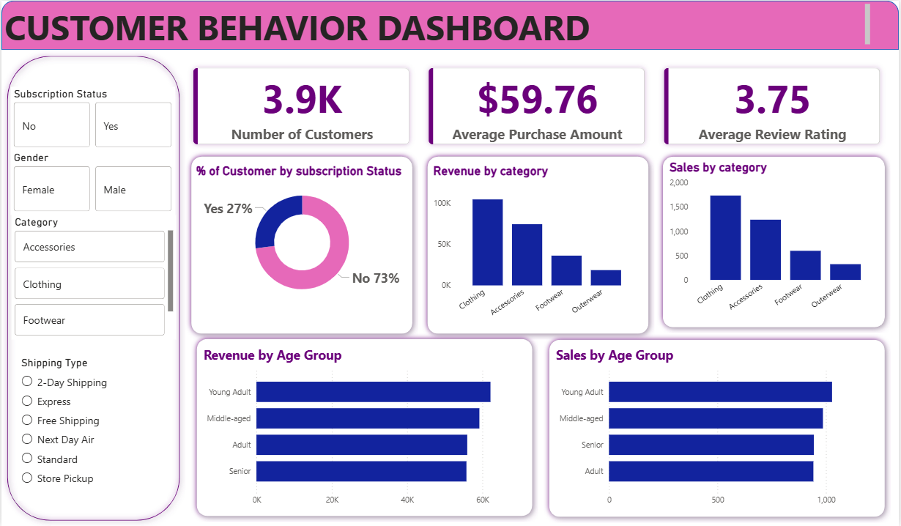
DASHBOARD (POWER BI)
Interactive charts
KPI tracking
Filters for analysis

Slide 13
THANK YOU !

